Slide 1
Unit 5
TRANSFORMATION OF PROJECTIONS

Slide 2
ISOMETRIC TO ORTHO PROJECTIONS

Slide 3
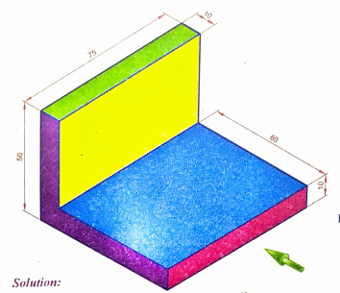
ISOMETRIC PROJECTION

Slide 4
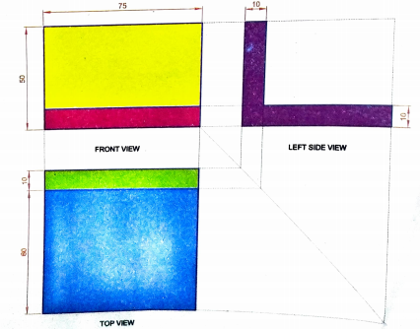
ISOMETRIC PROJECTION

Slide 5
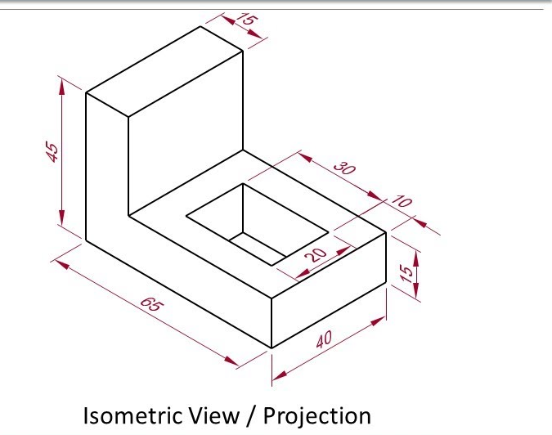
ISOMETRIC PROJECTION

Slide 6
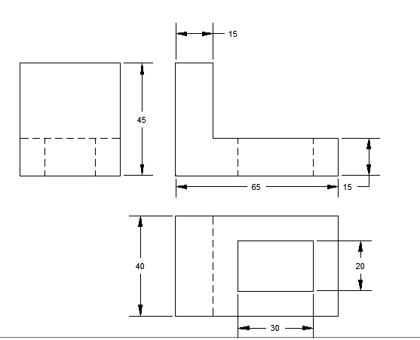
ISOMETRIC PROJECTION

Slide 7
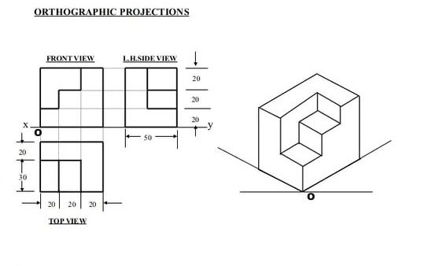
ISOMETRIC PROJECTION

Slide 8
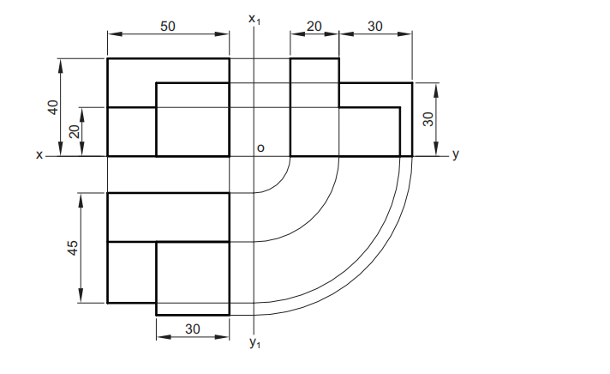
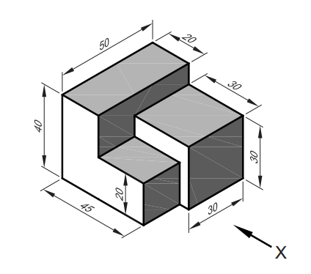

Slide 9
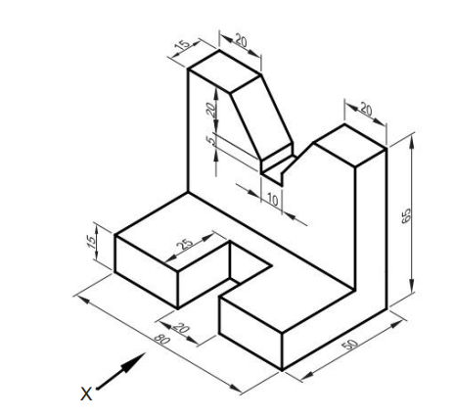
ISOMETRIC PROJECTION

Slide 10
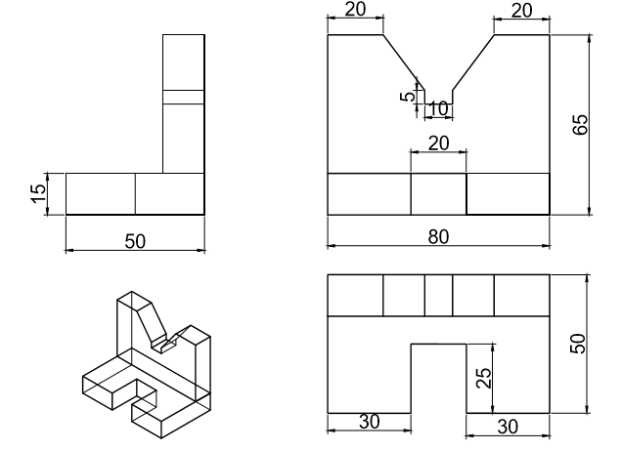
ISOMETRIC PROJECTION

Slide 11
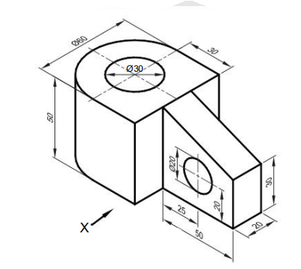
ISOMETRIC PROJECTION

Slide 12
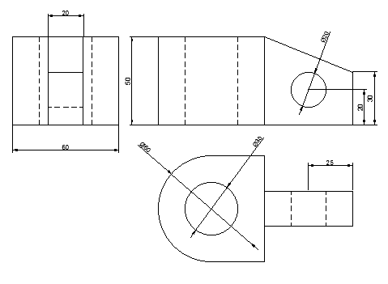
ISOMETRIC PROJECTION

Slide 13
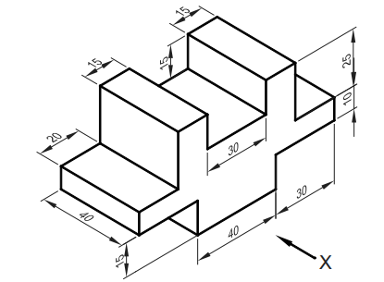

Slide 14
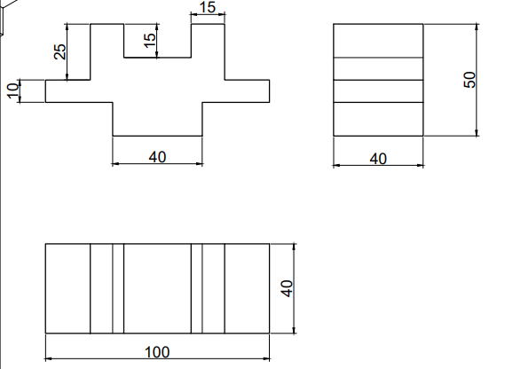

Slide 15
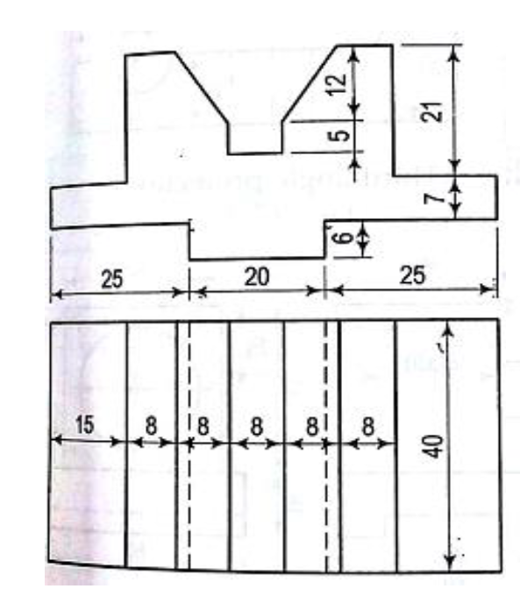
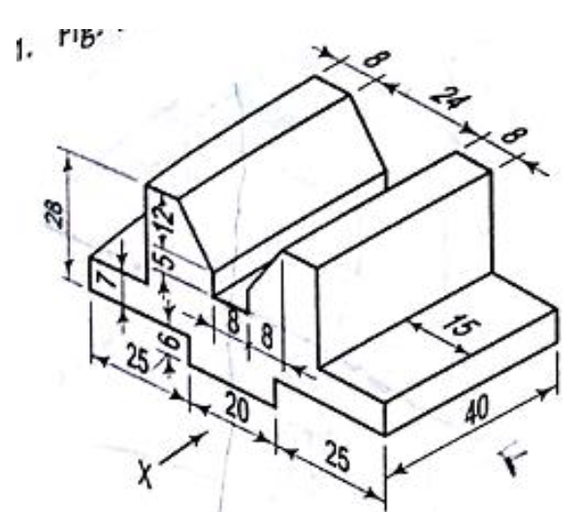
Draw the Ortho graphic views 1 front view, 2. Top view,3. Side view, & Isometric views of Following diagrams

Slide 16
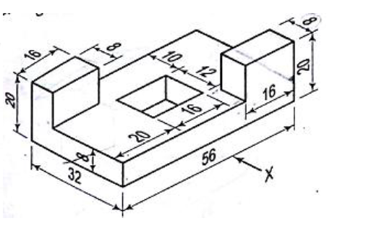
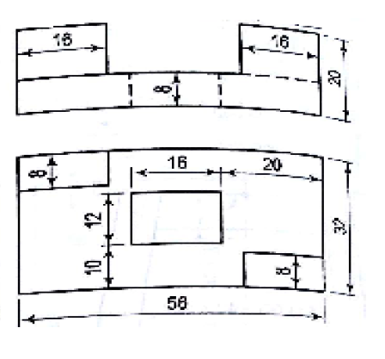
Draw the Ortho graphic views 1 front view, 2. Top view,3. Side view, & Isometric views of Following diagrams

Slide 17
Draw the Ortho graphic views 1 front view, 2. Top view,3. Side view, & Isometric views of Following diagrams

Slide 18
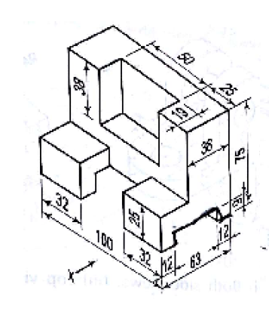
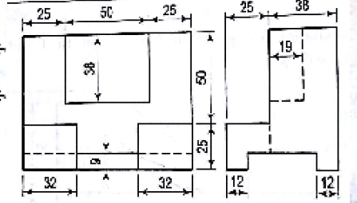
Draw the Ortho graphic views 1 front view, 2. Top view,3. Side view, & Isometric views of Following diagrams

Slide 19
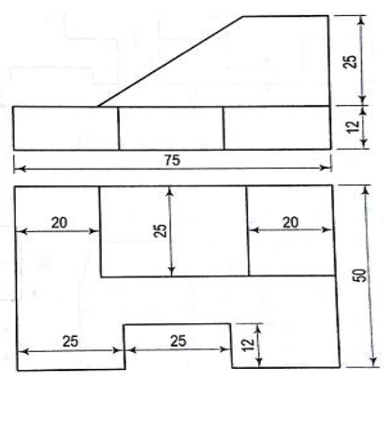
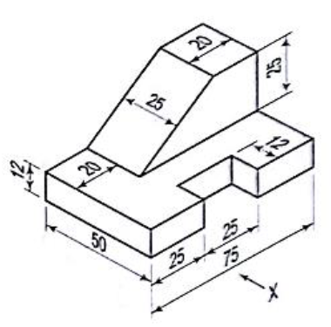
Draw the Ortho graphic views 1 front view, 2. Top view,3. Side view, & Isometric views of Following diagrams

Slide 20
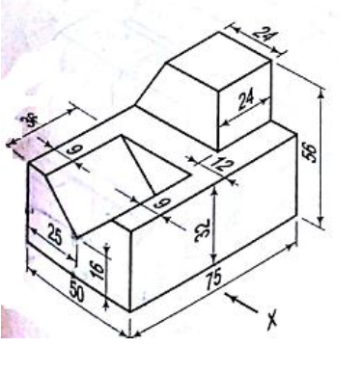
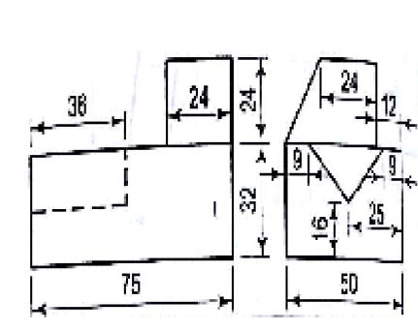
Draw the Ortho graphic views 1 front view, 2. Top view,3. Side view, & Isometric views of Following diagrams

Slide 21
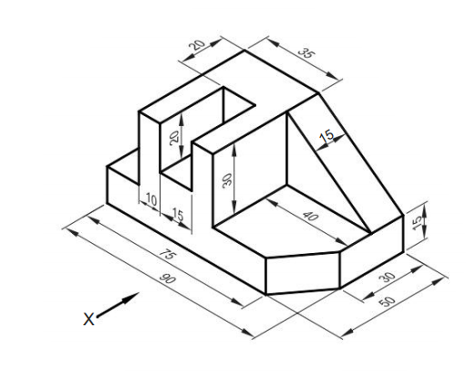

Slide 22
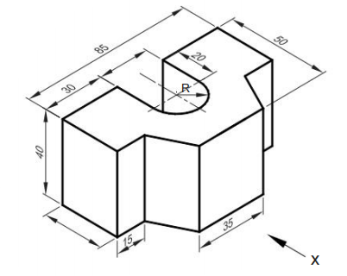

Slide 23
ORTHO TO ISOMETRIC PROJECTIONS

Slide 24
ORTHOGRAPHIC PROJECTION
A method for representing a three-dimensional object by means of several views from various planes.
FIRST ANGLE PROJECTION
In first angle projection, the object is considered to lie in the first angle, i.e., in front of the V.P. and above the H.P. The observer who is theoretically at infinite distance looks at the object from the front. The rays of sight are parallel to each other and perpendicular to the V.P. (See Fig. (a)). The view obtained on the V.P. is similar to the front face of the object and is known as front view. It may be noted that the front view shows only the length and height of the object. It does not indicate the width.

Slide 25
ORTHOGRAPHIC PROJECTION
FEATURES OF FIRST ANGLE PROJECTION
From the above discussions, the main features of the first angle projection can be summarised as follows:
1. The object lies in the first angle, i.e., in front of the V.P. and above the H.P.
2. The object lies between the observer and the plane of projection.
3. Top view is drawn below the front view.
4. Left-hand side view is drawn to the right side of the front view.
5. Right-hand side view is drawn to the left side of the front view.

Slide 26
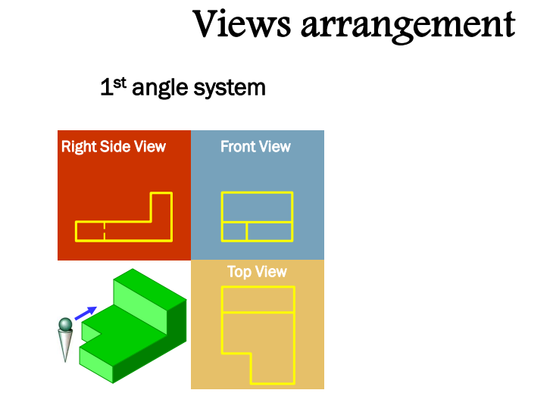
ORTHOGRAPHIC PROJECTION

Slide 27
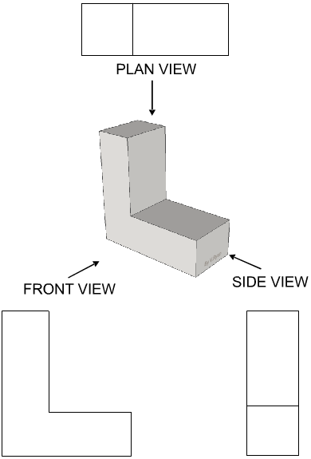
ORTHOGRAPHIC PROJECTION

Slide 28
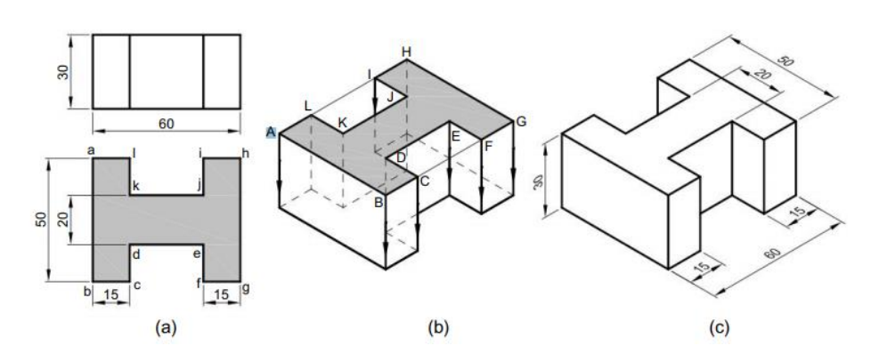
The front and top views of a casting are shown in Fig. Draw its isometric view

Slide 29
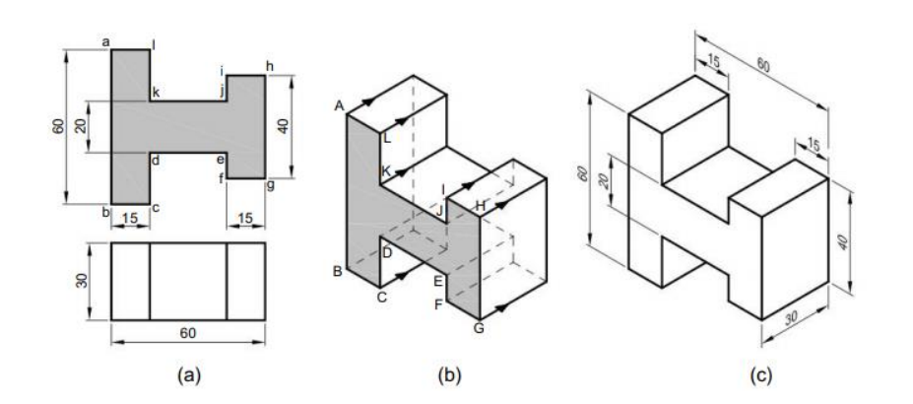
The front and top views of a casting are shown in Fig. Draw its isometric view

Slide 30
The front and top views of an angle plate are shown in Fig. Draw its isometric view.

Slide 31
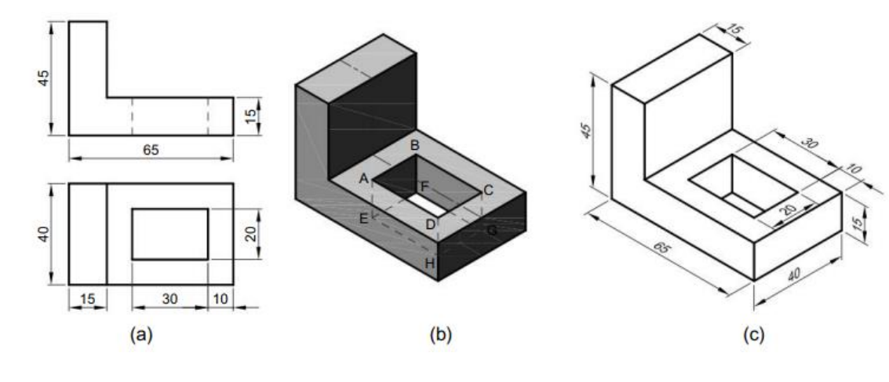
The front and top views of an angle plate are shown in Fig. Draw its isometric view.

Slide 32
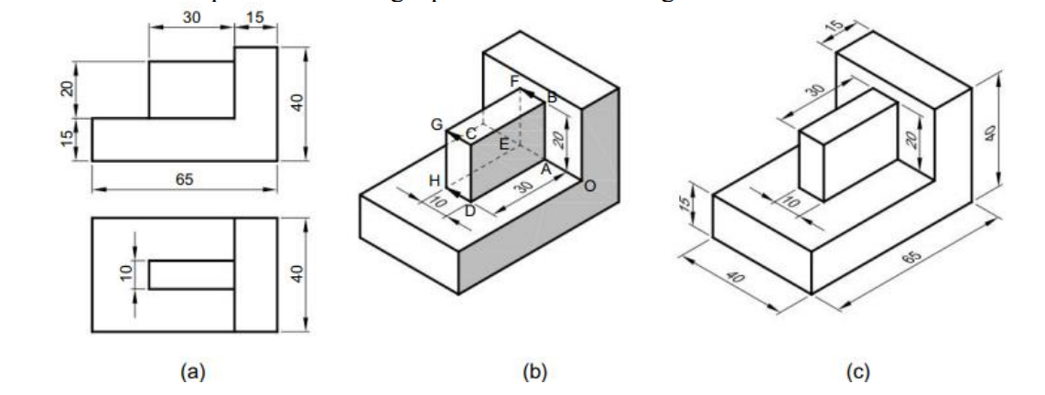
The front and top views of an angle plate are shown in Fig. Draw its isometric view.

Slide 33
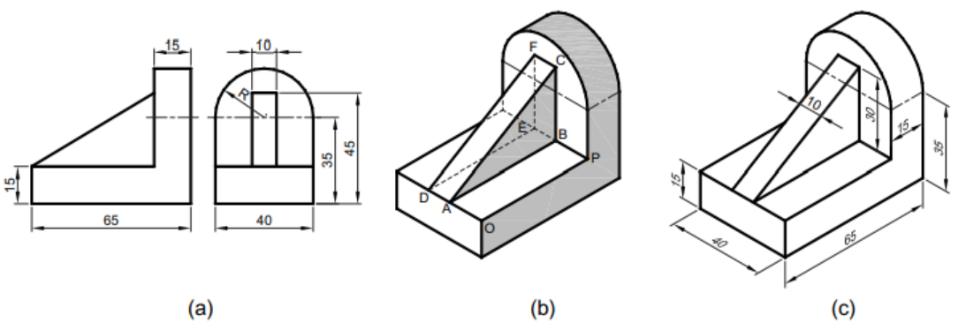
The front and top views of an angle plate are shown in Fig. Draw its isometric view.

Slide 34
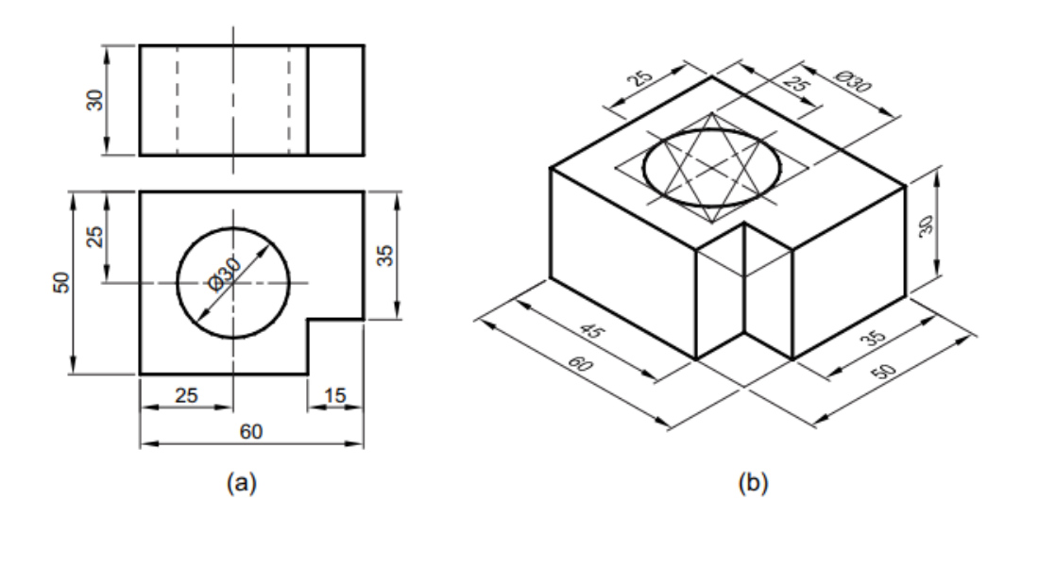
The front and top views of a casting are shown in Fig. Draw its isometric view.

Slide 35
The front and top views of a casting are shown in Fig. Draw its isometric view.

